Slide 1
MSFT Certification Exam Updates (Sep 2021)
By Lavinia

Slide 2
Azure certifications

Slide 3
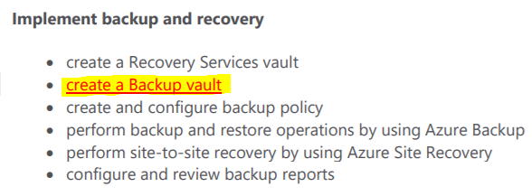
AZ-104 Azure Administrator
Microsoft Learn: AZ-104 Azure Administrator
Skills Measured
Certification Journey
September 24th
How is the exam
content changing?

Slide 4
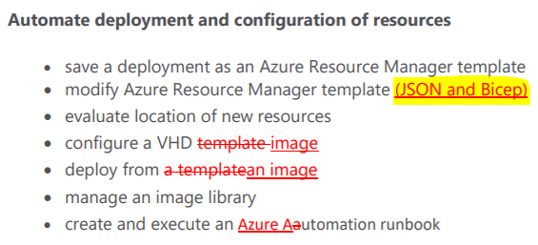
AZ-303 Azure Architect Technologies
Microsoft Learn: AZ-303 Azure Architect Technologies
Skills Measured
Certification Journey
September 24th
How is the exam
content changing?

Slide 5
AZ-304 Azure Architect Design
Microsoft Learn: AZ-304 Azure Architect Design
Skills Measured
Certification Journey
September 24th
How is the exam
content changing?

Slide 6
AZ-500 Microsoft Azure Security Technologies
Microsoft Learn: AZ-500 Microsoft Azure Security Technologies
Certification Journey
Skills Measured
September 29th
How is the exam
content changing?
SIGNIFICANT CHANGES !! See the Skills Measured doc. Microsoft Threat Modeling Tool and external identities are added etc

Slide 7
AZ-600 Configuring and Operating a Hybrid Cloud with Microsoft Azure Stack Hub
Microsoft Learn: AZ-600 Configuring and Operating a Hybrid Cloud with Microsoft Azure Stack Hub
Certification Journey
Skills Measured
September 24th
How is the exam
content changing?

Slide 8
AZ-700 Designing and Implementing Microsoft Azure Networking Solutions
Microsoft Learn: AZ-700 Designing and Implementing Microsoft Azure Networking Solutions
Skills Measured

Slide 9
AI-102 Designing and Implementing a Microsoft Azure AI Solution
Microsoft Learn: AI-102 Designing and Implementing a Microsoft Azure AI Solution
Skills Measured
Certification Journey
September 24th
How is the exam
content changing?

Slide 10
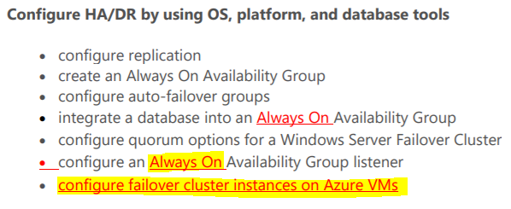
DP-300 Administering Relational Databases on Microsoft Azure
Microsoft Learn: DP-300 Administering Relational Databases on Microsoft Azure
Skills Measured
Certification Journey
September 24th
How is the exam
content changing?

Slide 11
AZ-400 Designing and Implementing Microsoft Azure DevOps Solutions
Microsoft Learn:AZ-400 Designing and Implementing Microsoft Azure DevOps Solutions
Skills Measured
Certification Journey
September 29th
How is the exam
content changing?

Slide 12
AZ-120 Planning and Administering Microsoft Azure for SAP Workloads
Microsoft Learn:AZ-120 Planning and Administering Microsoft Azure for SAP Workloads
Skills Measured
Certification Journey
September 24th
How is the exam
content changing?

Slide 13
AZ-140 Configuring and Operating Microsoft Azure Virtual Desktop
Microsoft Learn: AZ-140 Configuring and Operating Microsoft Azure Virtual Desktop
Skills Measured
Certification Journey
September 24th
How is the exam
content changing?

Slide 14
AZ-220 Microsoft Azure IoT Developer
Microsoft Learn: AZ-220 Microsoft Azure IoT Developer
Skills Measured
Certification Journey
September 24th
How is the exam
content changing?

Slide 15
MICROSOFT 365 certifications

Slide 16
MS-100 Microsoft Identity and Services
Microsoft Learn: MS-100 Microsoft Identity and Services
Skills Measured
September 29th
How is the exam
content changing?

Slide 17
MS-101 Microsoft 365 Mobility and Security
Microsoft Learn: MS-101 Microsoft 365 Mobility and Security
Skills Measured
September 24th
How is the exam
content changing?

Slide 18
MS-500 Microsoft 365 Security Administration
Microsoft Learn: MS-500 Microsoft 365 Security Administration
Skills Measured
Certification Journey
September 24th
How is the exam
content changing?
SIGNIFICANT CHANGES !! See the Skills Measured doc.

Slide 19
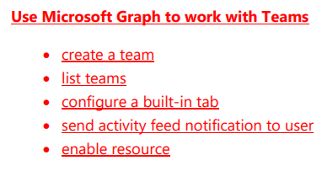
MS-600 Building Applications and Solutions with Microsoft 365 Core Services
Microsoft Learn: MS-600 Building Applications and Solutions with Microsoft 365 Core Services
Skills Measured
Certification Journey
September 24th
How is the exam
content changing?

Slide 20
MS-700 Managing Microsoft Teams
Microsoft Learn: MS-700 Managing Microsoft Teams
Skills Measured
Certification Journey
September 24th
Adding:
Manage Notifications & alerts rules from the Microsoft Teams admin center
Plan and configure emergency Calling Policies
How is the exam
content changing?

Slide 21
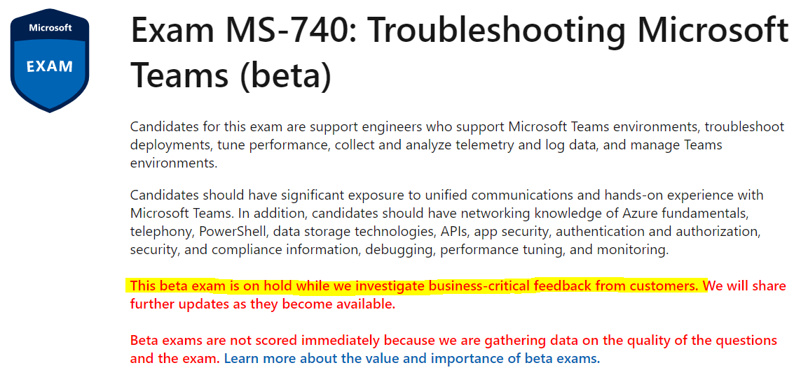
MS-740 Troubleshooting Microsoft Teams
Microsoft Learn: MS-740 Troubleshooting Microsoft Teams
Skills Measured

Slide 22
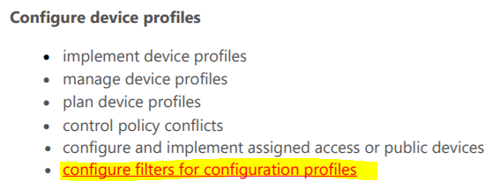
MD-101 Managing Modern Desktops
Microsoft Learn: MD-101 Managing Modern Desktops
Skills Measured
Certification Journey
September 24th
How is the exam
content changing?

Slide 23
SECURITY certifications

Slide 24
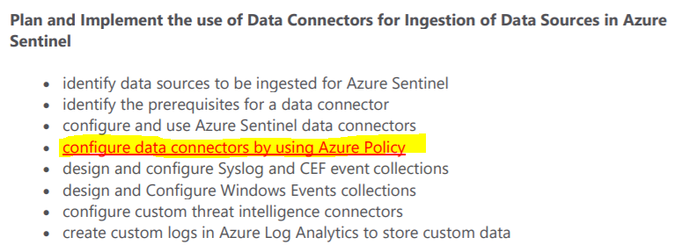
SC-200 Microsoft Security Operations Analyst
Microsoft Learn: SC-200 Microsoft Security Operations Analyst
Skills Measured
September 24th
How is the exam
content changing?

Slide 25
SC-300 Microsoft Identity and Access Administrator
Microsoft Learn: SC-300 Microsoft Identity and Access Administrator
Skills Measured
September 24th
How is the exam
content changing?

Slide 26
DYNAMICS 365 certifications

Slide 27
MB-340 Microsoft Dynamics 365 Commerce Functional Consultant
Microsoft Learn: MB-340 Microsoft Dynamics 365 Commerce Functional Consultant
Skills Measured
Certification Journey

Slide 28
POWER PLATFORM certifications

Slide 29
DA – 100 Analyzing Data with Microsoft Power BI
Microsoft Learn: DA - 100 Analyzing Data with Microsoft Power BI
Skills Measured
Certification Journey
September 24th
How is the exam
content changing?
The following topics are added:
Model the Data - Apply or change Sensitivity Labels
Visualize the Data - Add a Smart Narrative visual
Analyze the Data - Use Anomaly Detection

Slide 30
PL-200: Microsoft Power Platform Functional Consultant
Microsoft Learn: PL-200: Microsoft Power Platform Functional Consultant
Skills Measured
Certification Journey
October 1st
How is the exam
content changing?
SIGNIFICANT CHANGES !! See the Skills Measured doc.

Slide 31
BEST OF LUCK IN YOUR EXAM!

